Slide 1
How to use IDSP Helpdesk / How to Report problem

Slide 2
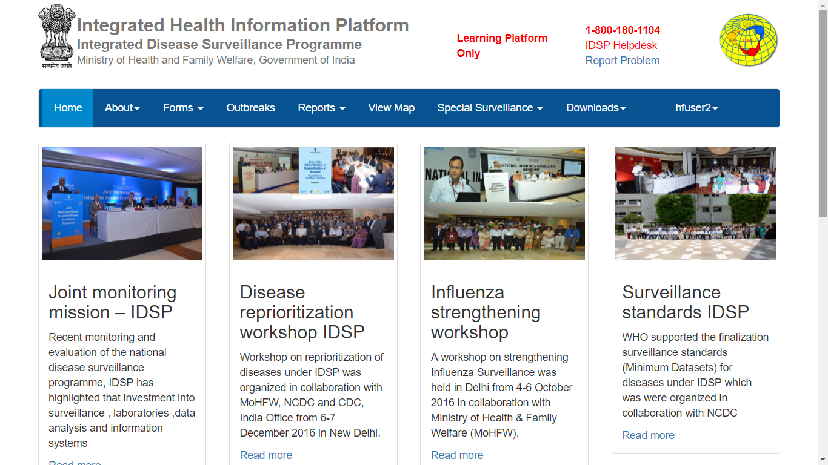
The home page that you will see after log in

Slide 3
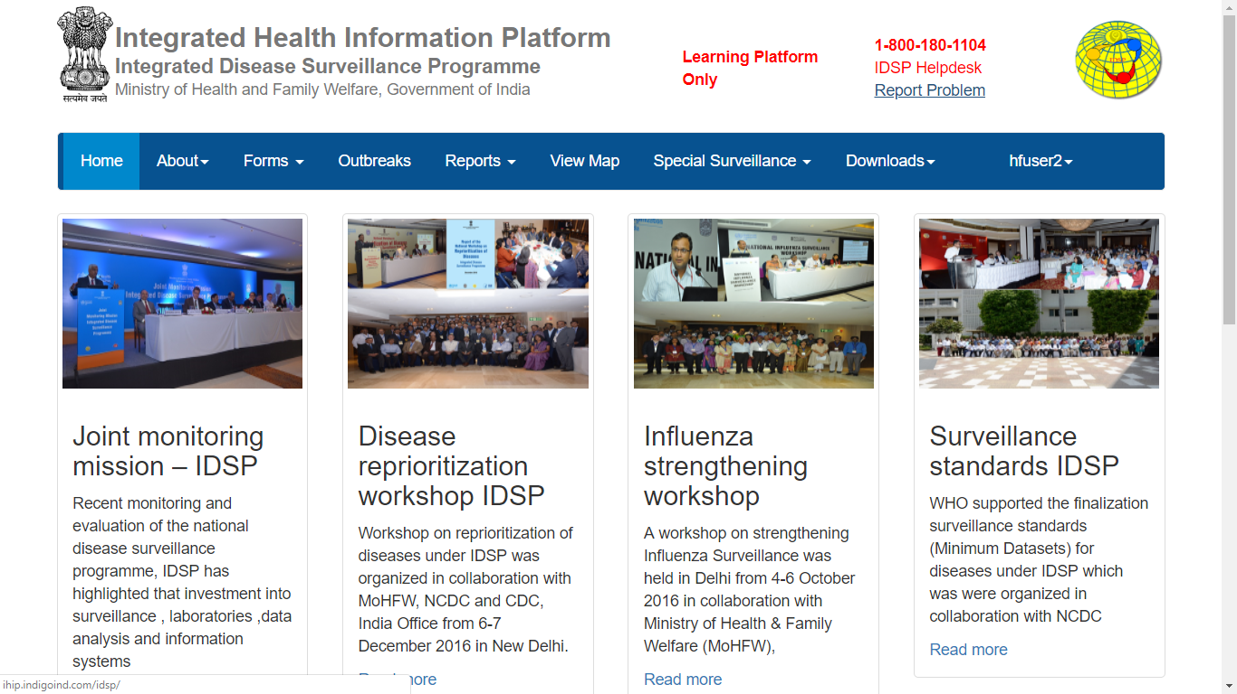
Click “Report Problem”

Slide 4
“Report Problem” page of Helpdesk would look like this; if you have already logged in then “Requester Details” will be filled in automatically based on details filled in User details; otherwise one has to fill in all these details
Click on “Problem Category”

Slide 5
Click on “Facility / IT Infrastructure Related”

Slide 6
These are the Problem Types available under “Facility / IT infrastructure Related” Problem Category; as these issues are beyond the control of the IT programmers handling the website, they need to be sorted at the local level

Slide 7
Click on “Software Related”

Slide 8
These are the Problem Types available under “Software Related” Problem Category; as these issues are related to the IHIP web-portal /software, IT programmers will help you to sort these issue once you submit the issue/s

Slide 9
Click on “Unable to save the Forms” for example

Slide 10
Describe the details of the problem in “Problem Description”; describing the details of the problem is very important so that the programmers can understand and resolve it as soon as possible

Slide 11
Attaching any photo or screenshot or document, that can help the programmer to understand the problem, is also as important as ‘Problem Description’

Slide 12
Then click on “Submit” to submit the problem

Slide 13
On successful submission of the problem, you will see this message with the docket number (which is the number given to each problem); you don’t need to remember the docket number
Now click on “My Service Request List”

Slide 14
You will see the list of all the requests generated by your user account

Slide 15
You can also see the “Request Status” of all the requests as well

Slide 16
click on this docket number

Slide 17
You will see all the details in relation to the request generated by you

Slide 18
You will find the comments of the programmer once the programmer responds to your request (not shown here)

Slide 19
Once the programmer solves your issue, the programmer will change the status to “Resolved”

Slide 20
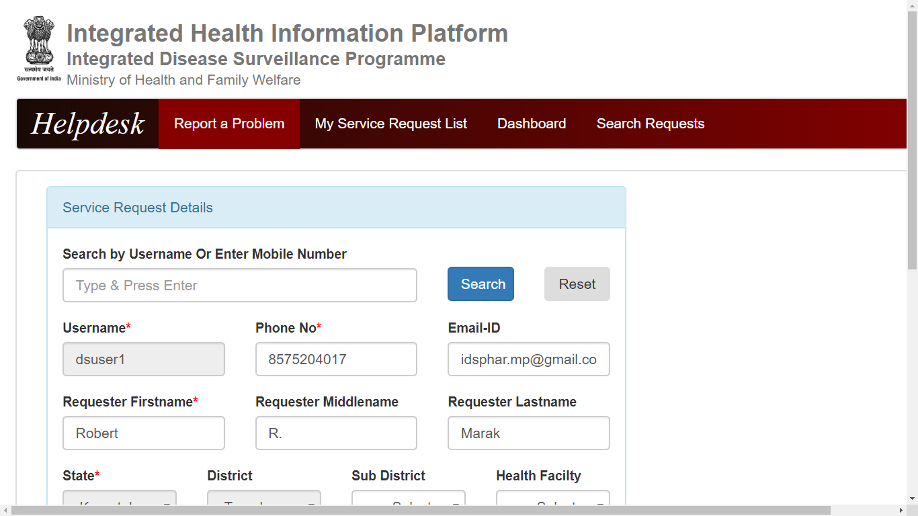
The Helpdesk page of District level user (and other higher level users like state level users, national users) have 2 more menus: “Dashboard” and “Search Requests”

Slide 21
Let’s click on “Dashboard” first

Slide 22
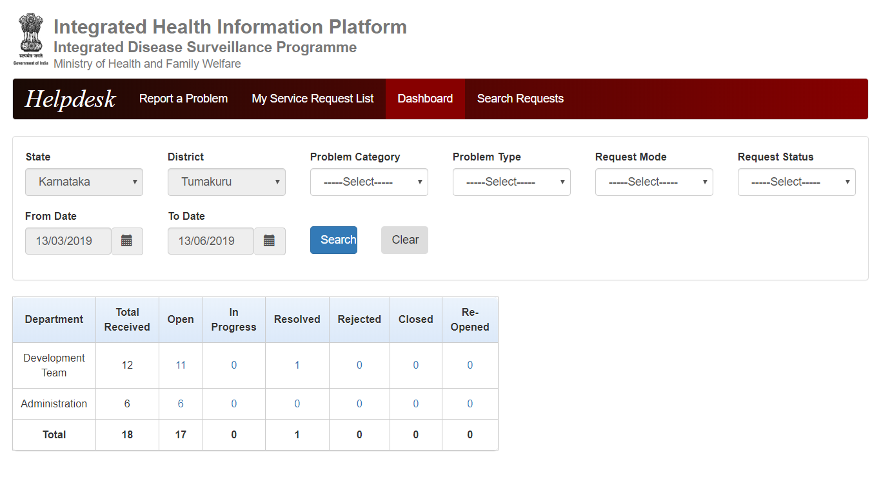
One can see the frequency table of Number of requests generated in the district with distribution by “Department” and “Request Status” with total number of requests Received

Slide 23
Problems categorized under “Development Team” are “Software Related” problems where the role of IT team comes to rectify the IHIP portal related issues faced by the user/s
Problems categorized under “Administration” are basically the “Facility / IT infrastructure Related” which can be solved only by local / state government &/or GoI

Slide 24
One can use the filters above to change the frequency table figures and can drill down to some specific groups of problem requests generated

Slide 25
Let’s click on the figure under “Resolved”

Slide 26
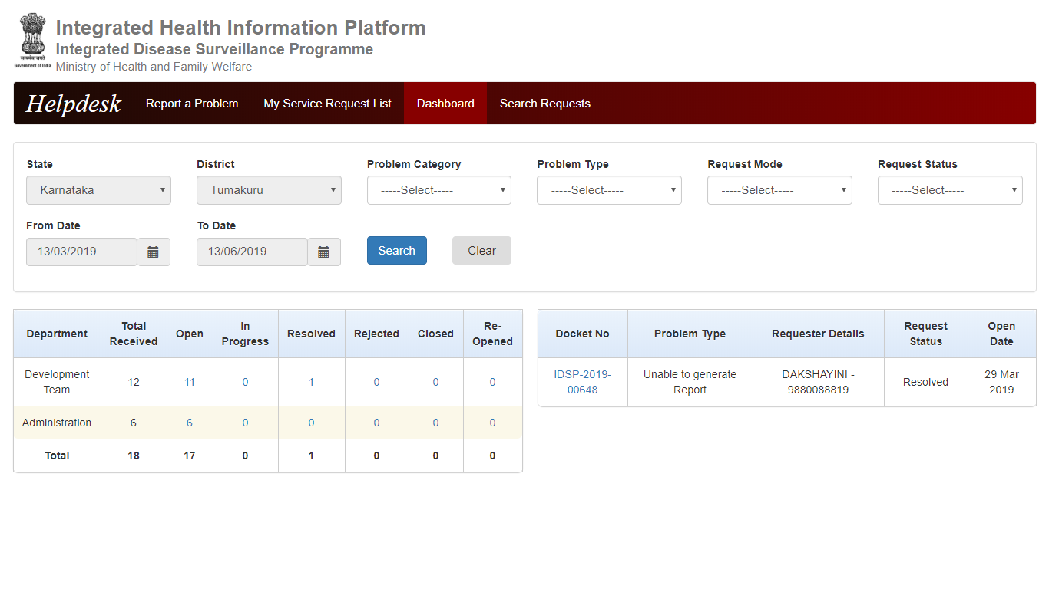
It will show you the list of all the “Resolved” problems for that district; here it’s only one so it’s showing that only
Now let’s click on the docket number of this request

Slide 27
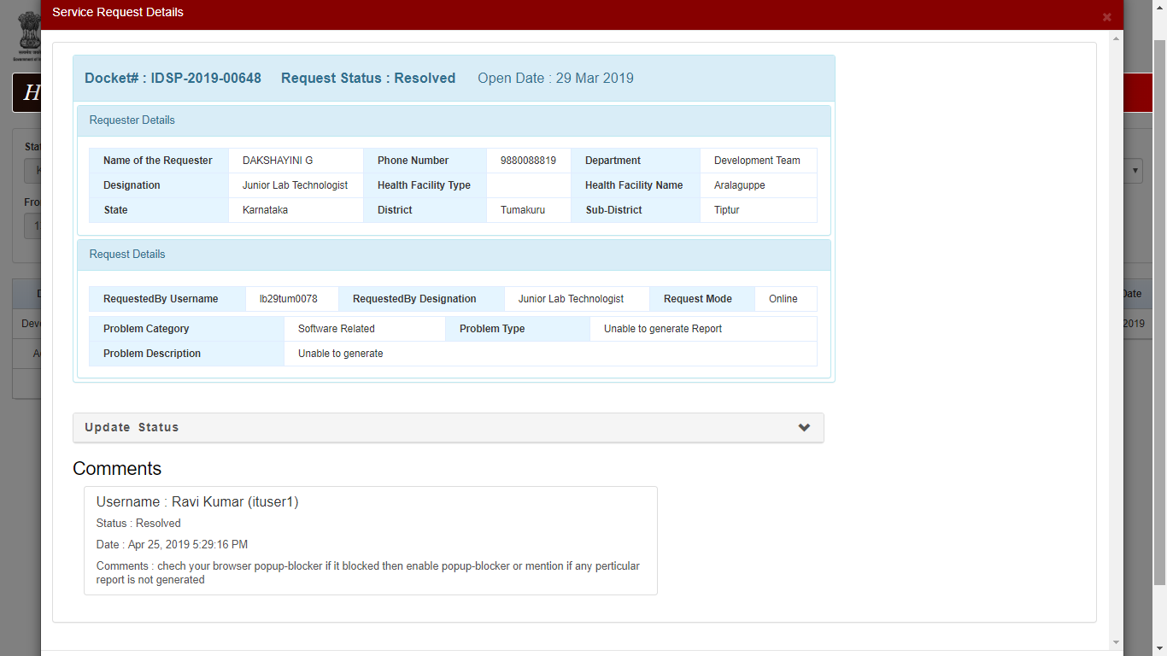
The Upper part of the page will show Docket Number, Request Status, Open Date, “Requester Details” and “Request Details”
The lower part of the page shows the comments by IT user with status being changed and the date and time of updating the status

Slide 28
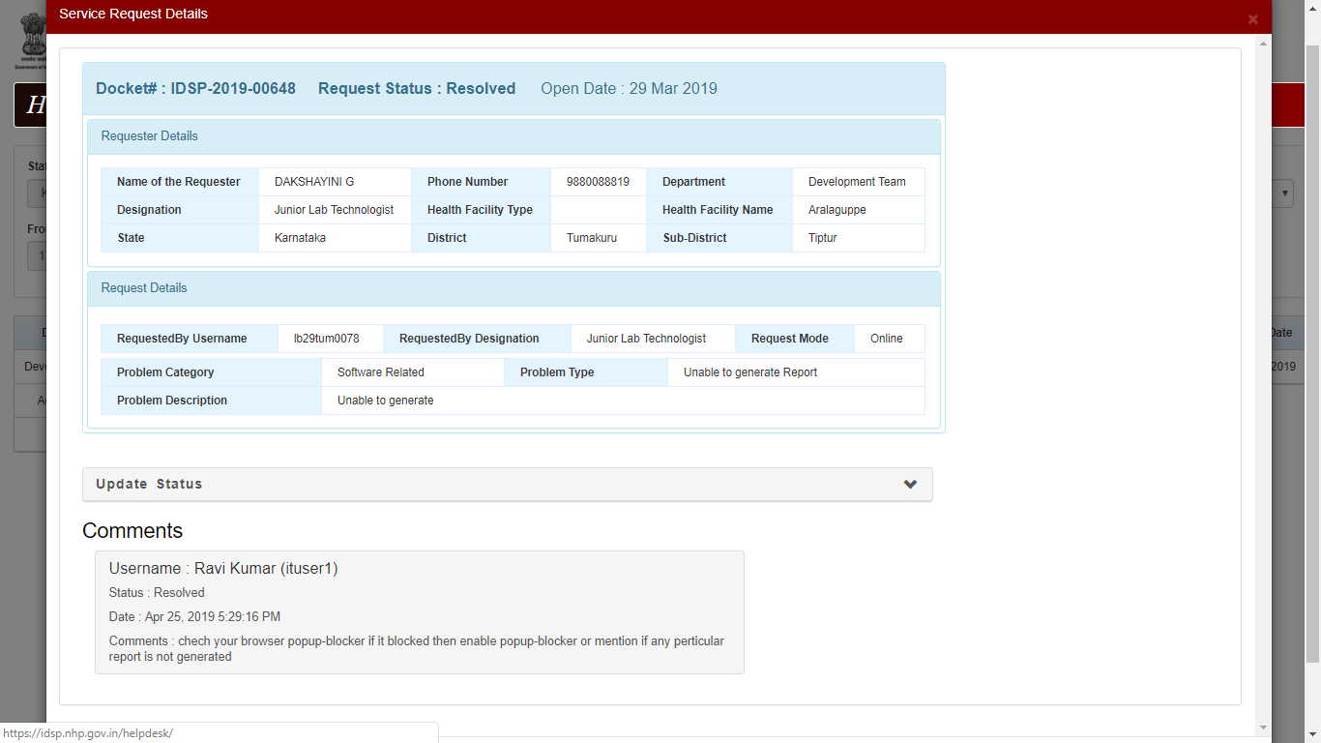
Click on the down arrow in front of “Update Status”

Slide 29
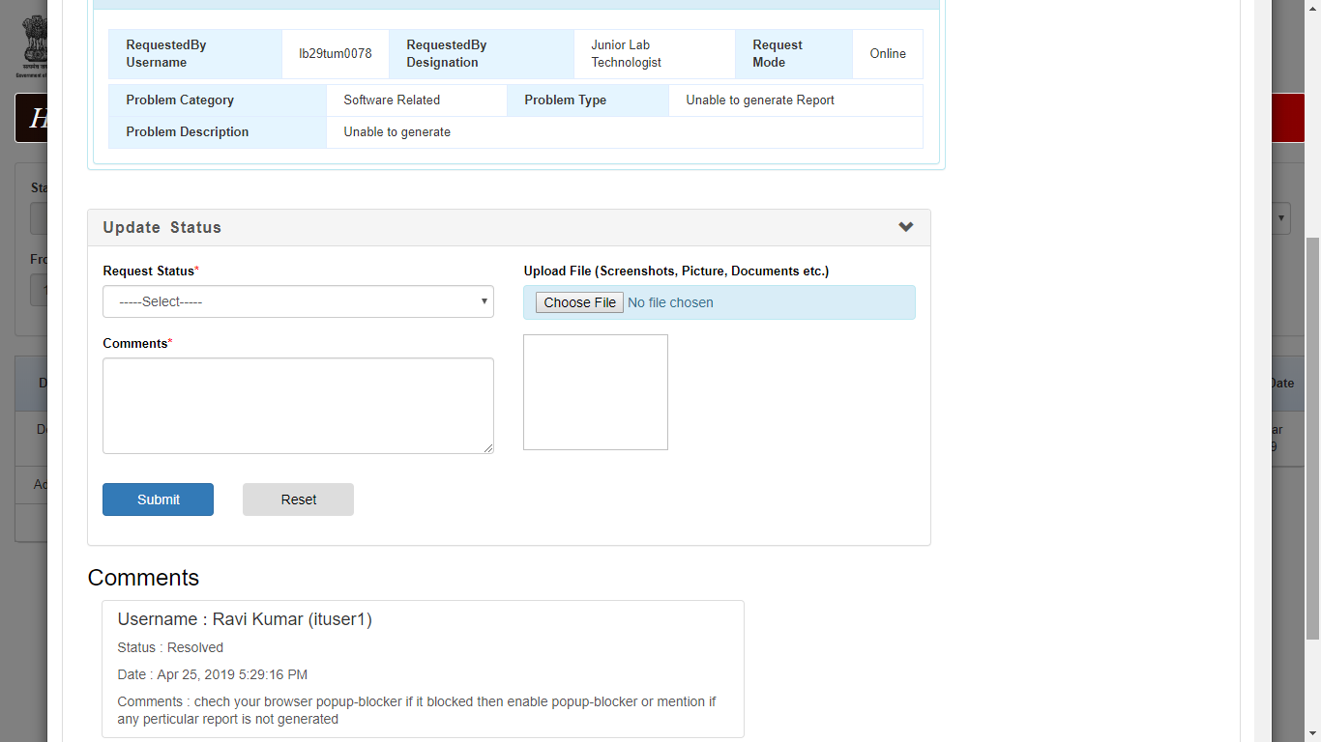
Another box will open up on the same page for district level users to change the “Request Status” from his or her side, put any “Comments” and “Upload File”

Slide 30
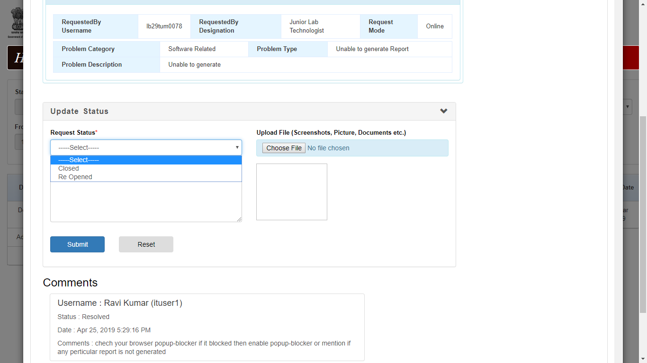
The district level user can either “Close” the Resolved request or “Reopen” the Resolved request based on the information provided by the health facility user of the concerned problem request; health facility user CANNOT REOPEN the problem said to be RESOLVED by IT team

Slide 31
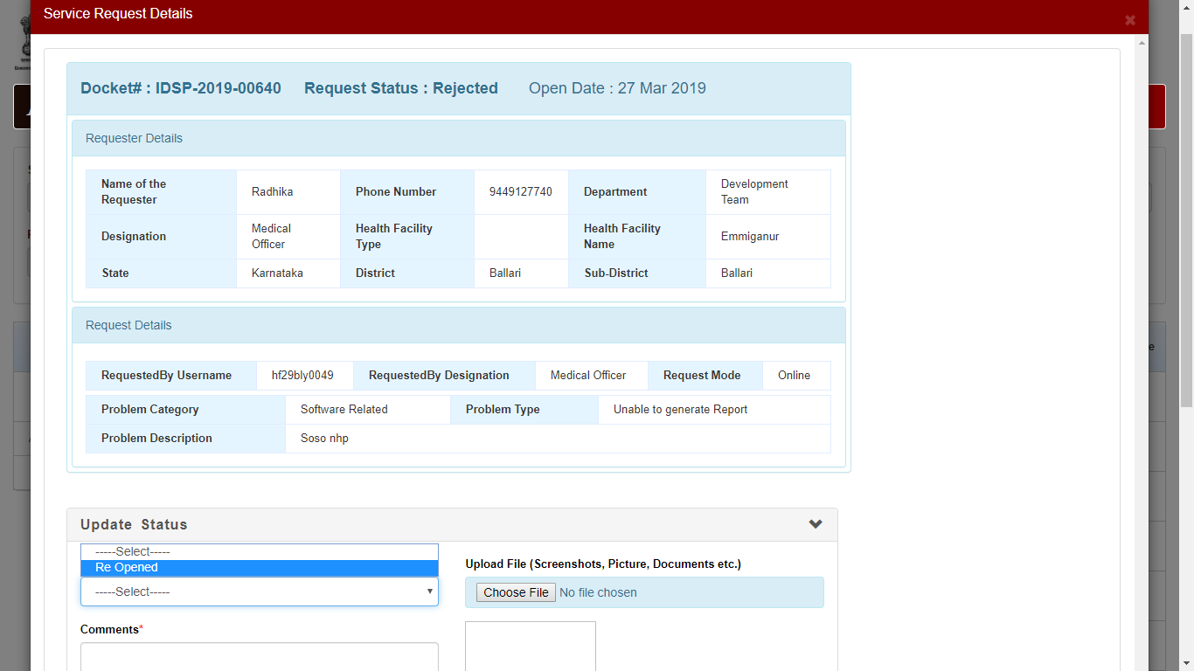
`
Similarly, The district level user can “REOPEN” the request REJECTED by the IT user, the health facility user CANNOT “REOPEN” the request said to be REJECTED by the IT user

Slide 32
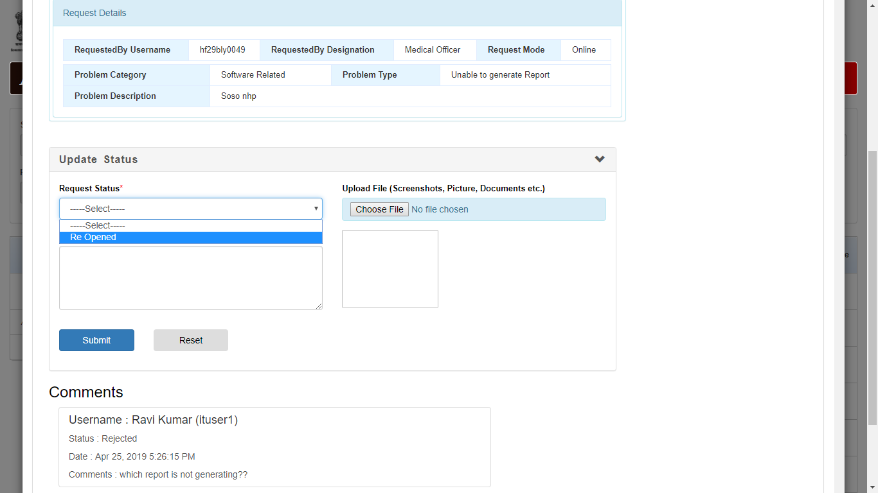
Similarly, The district level user can “REOPEN” the request REJECTED by the IT user; the health facility user CANNOT “REOPEN” the request said to be REJECTED by the IT user

Slide 33
Now, let’s click on “Search Requests”

Slide 34
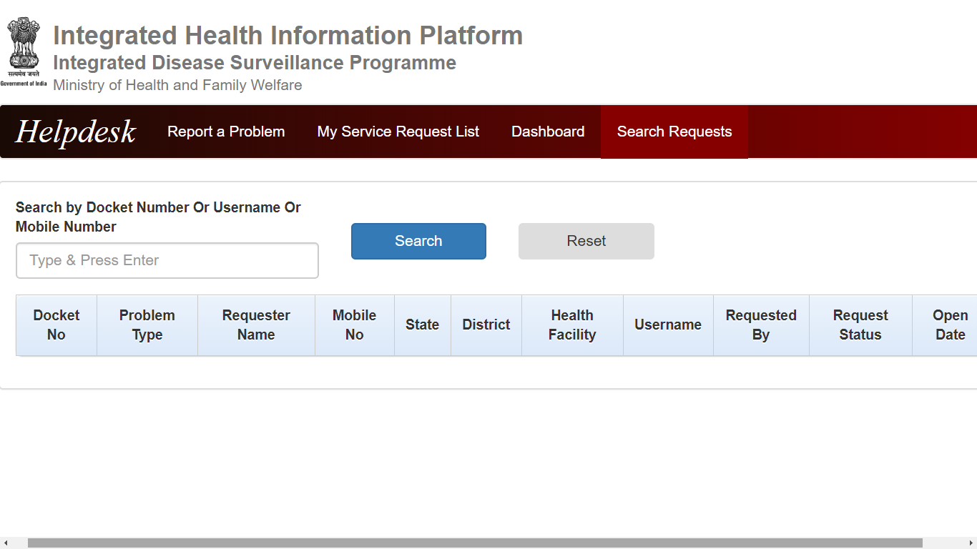
Basically this page helps the district level user to search the Problem Requests by Docket Number / Username / Mobile Number

Slide 35
Thank You

