Slide 1
Manage User Accounts
We shall discuss about this new feature using district admin user ID

Slide 2
Manage User Accounts (under administration menu)
This new feature has been added to help District Admin to manage the user accounts of various IDSP facilities including S form users, P form users, L form user, RRT users

Slide 3
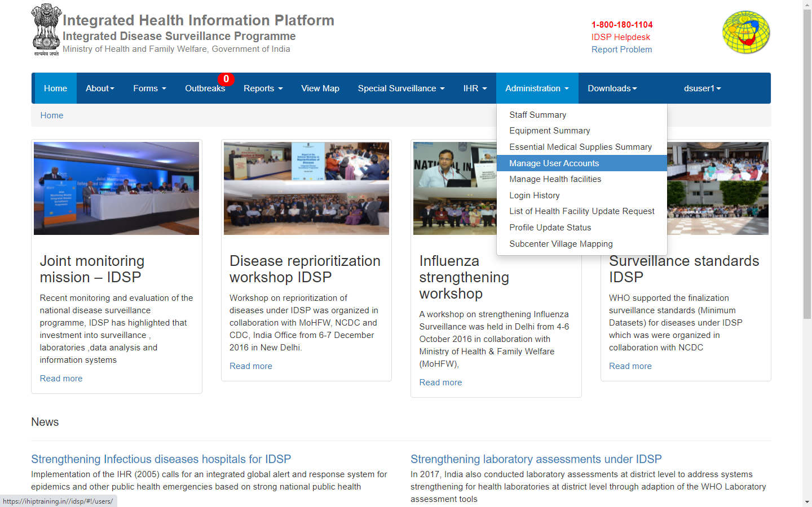
Click on ‘Manage User Accounts’ under “Administration” menu

Slide 4
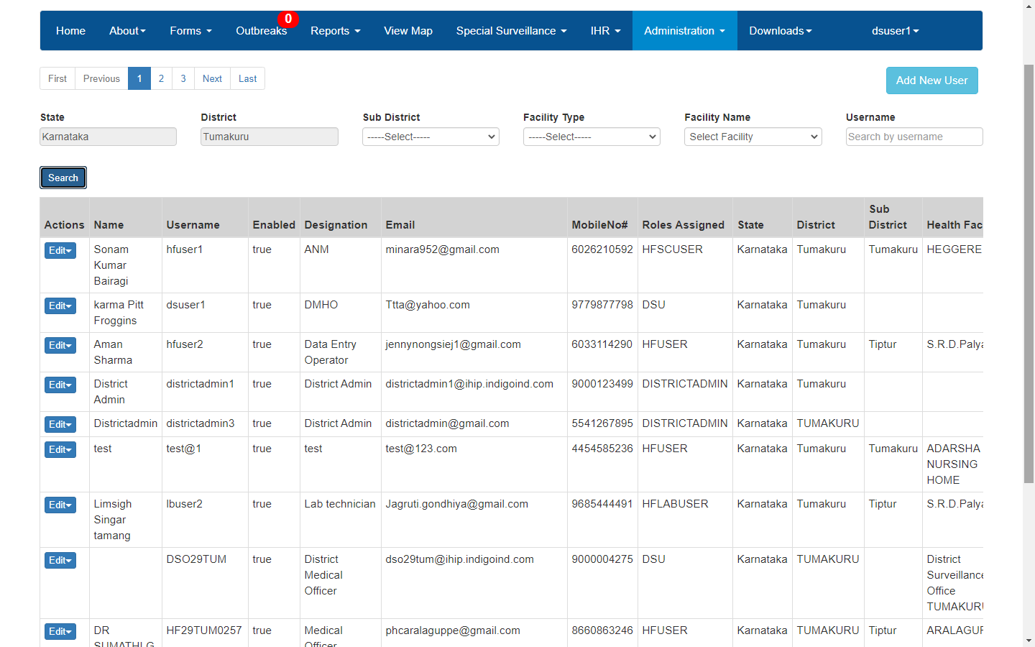
One can use various filters to drill down to specific user or group of users and then click on ‘Search’

Slide 5
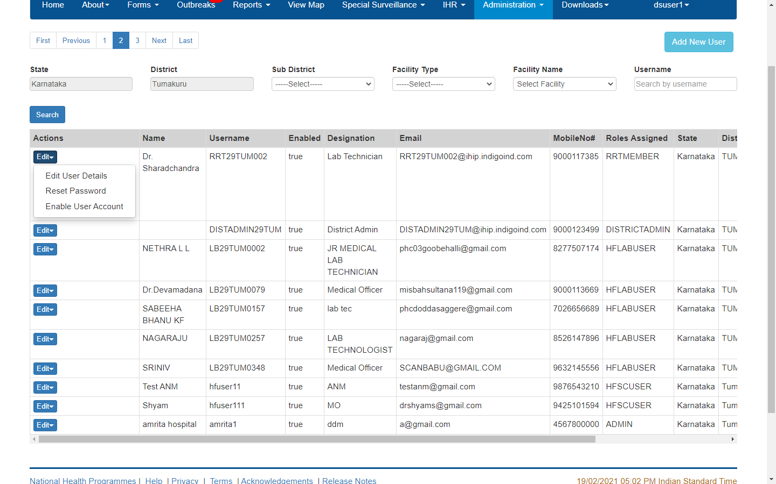
‘Edit’ button enables the district admin user
To change the details of the user by ‘Edit User Details’
To change the password of the user by ‘Reset Password’
To ‘Enable User Account’ if the account was frozen due to non activity for continuous 30 days

Slide 6
District admin can add the new user by ‘Add New User’ button

Slide 7
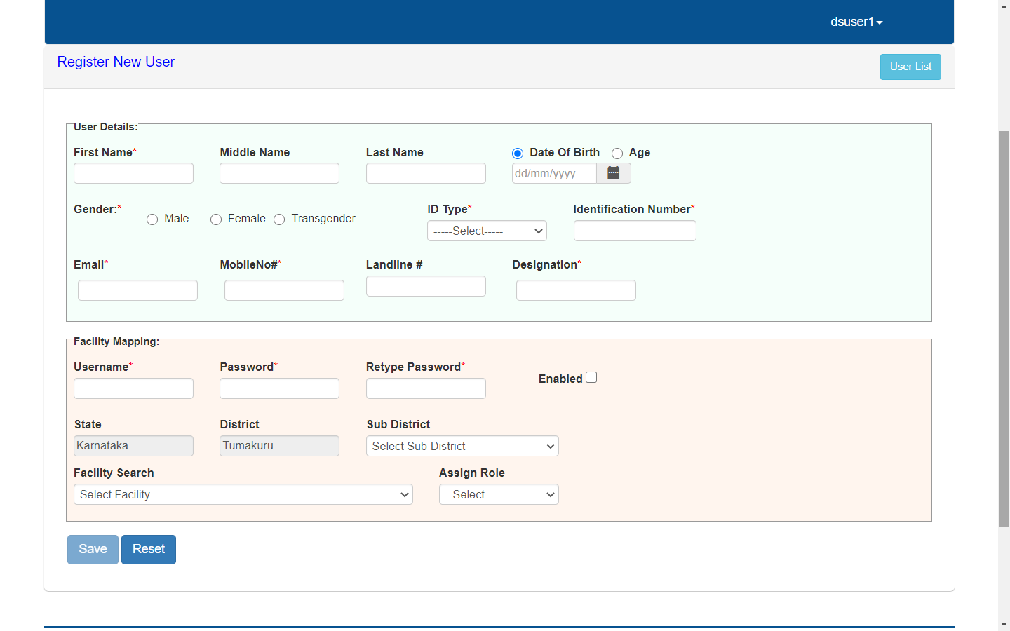
District admin needs to fill in the details of the New User and also needs to link it with the facility for which the user will be doing the data entry along with giving username and password for the new user; once all the mandatory fields are filled in, click on ‘Save’ to add new user

