Slide 1
L form entry and other functions of L form user account

Slide 2
Learning Objectives
Fill in the remaining fields in case of Auto Forwarded (from P form user) Line List
Fill in fresh L form
Reports and View Map

Slide 3
For Factual data entry, type or copy-paste https://ihip.nhp.gov.in/idsp/#!/login in URL in the web browser
Here, for demonstration purpose, we will be using Learning Platform which is http://ihiptraining.in/idsp/#!/login

Slide 4
After typing the relevant link in the URL, you will come to the “Sign In” page
Write Username and Password in the relevant fields and enter the CAPTCHA; then click on “Sign In” button to log in

Slide 5
The home page that you will see after log in

Slide 6
If you are logging in for the first time then please go to different submenu under the Username like “My Profile”, “View Facility Information” etc as described in the ppt named “Things to be seen or done on first log in by the User”

Slide 7
Now let’s see how L form user can fill in L form
One type of L form will be such that the details will be auto forwarded from P form
In other type, L form user needs to feel in every detail of the patient, clinical details and laboratory sample details

Slide 8
Let’s click on “Forms” and then
click on “Laboratory Cases Form”

Slide 9
This is how the web page looks after clicking on “Forms → Laboratory Cases form”
Line List of the cases forwarded from the P form user of the linked health facility

Slide 10
…To fill in the pending fields concerned with Lab
Click “Edit”…

Slide 11
These fields will be already filled in from the P form of the linked Health Facility
Only these fields remain to be filled in

Slide 12
Once these fields are filled in…
…then click “Update”

Slide 13
Click “Summary” to view the summary of Test Results updated

Slide 14
Scroll Down

Slide 15
You will see the summary of data updated: name of the Test performed; Total Number of Samples tested and Total number of Positives

Slide 16
Read this mouse over message carefully
The lab user can similarly update the results of other cases; then lab user can submit Updated line-list with results by clicking on “Submit”; user ‘Print’ button on left upper side to get the pdf of this page before submitting to the server

Slide 17
Click “Yes”

Slide 18
The message of “Records Submitted Successfully” will appear for few seconds

Slide 19
Most of the cases in L form will be auto-forwarded from P form of the linked health facility but in some cases the patient might visit the lab directly in which the case details need to be filled in freshly in L form by L form user
Let’s take an example of fresh entry of L form

Slide 20
Let’s again click on “Forms” and then
click on “Laboratory Cases Form”

Slide 21
Click on “Add Patient Record” to start entering the fresh L form entry

Slide 22
As you can see that L form is very much similar to P form; the only difference is that the Lab user can put Test Results

Slide 23
Fill in the “Patient Details” especially the mandatory field just like P form

Slide 24
Now Select the provisional diagnosis; as you can see that the selection of provisional diagnosis generates a new box named “Laboratory Details”

Slide 25
`
Also select the Date of Onset and select between OPD & IPD

Slide 26
Now Fill in the “Laboratory Details”
Then click on “Save”

Slide 27
Now Scroll Down
The message of “Data Saved Successfully” appear for few seconds

Slide 28
One can see the newly added patient’s details (including lab results) at the bottom of the line list
Then click on “Summary”

Slide 29
Scroll Down

Slide 30
You will see the summary of data updated: name of the Test performed; Total Number of Samples tested and Total number of Positives
Now Scroll Up at the top of L form page

Slide 31
Before submitting the data, you may click on “Print” to take a pdf / print of the current L form page which contains the data in aggregate in the current L form page along with the line list of the cases with or without updated results; the pdfs and/or prints can be kept for Records or Future reference; the same can be used to get the data authenticated by the officer in charge of the facility / Lab before submitting the data to the server

Slide 32
This is how the report would look like; you can take a print or download the pdf and then take a print
Now Scroll Down

Slide 33
You will see the summary of data updated: name of the Test performed; Total Number of Samples tested and Total number of Positives just like you saw on “summary” page

Slide 34
In addition you will also see the line-list of the cases with the test results as seen on L form page
Now close this pdf or tab and go back to the website to submit the records saved

Slide 35
Read this mouse over message carefully
Click “Submit”

Slide 36
Click “Yes”

Slide 37
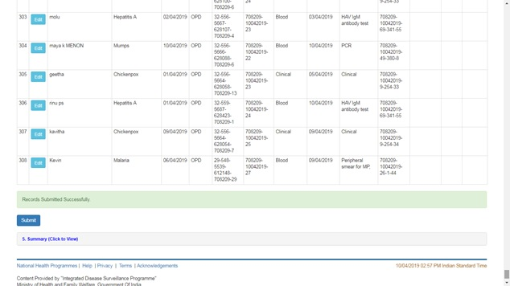
The message of “Records Submitted Successfully” will appear for few seconds

Slide 38
The case details will disappear from this line list

Slide 39
Now let’s go through some of the Reports which are available to the Lab user

Slide 40
Various reports available under “Reports” menu in L form (Labs of Health Facility-PHC & higher) account user; let’s see each of them one by one

Slide 41
Click on “Disease Summary”

Slide 42
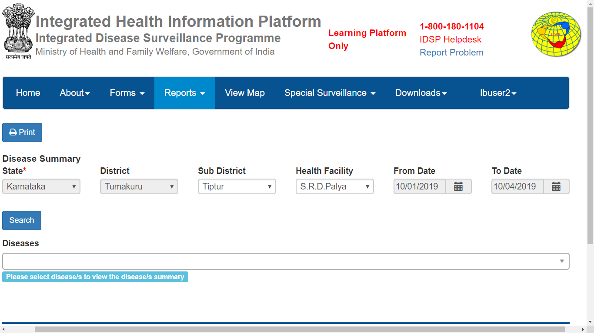
Click here to receive the List of Diseases

Slide 43
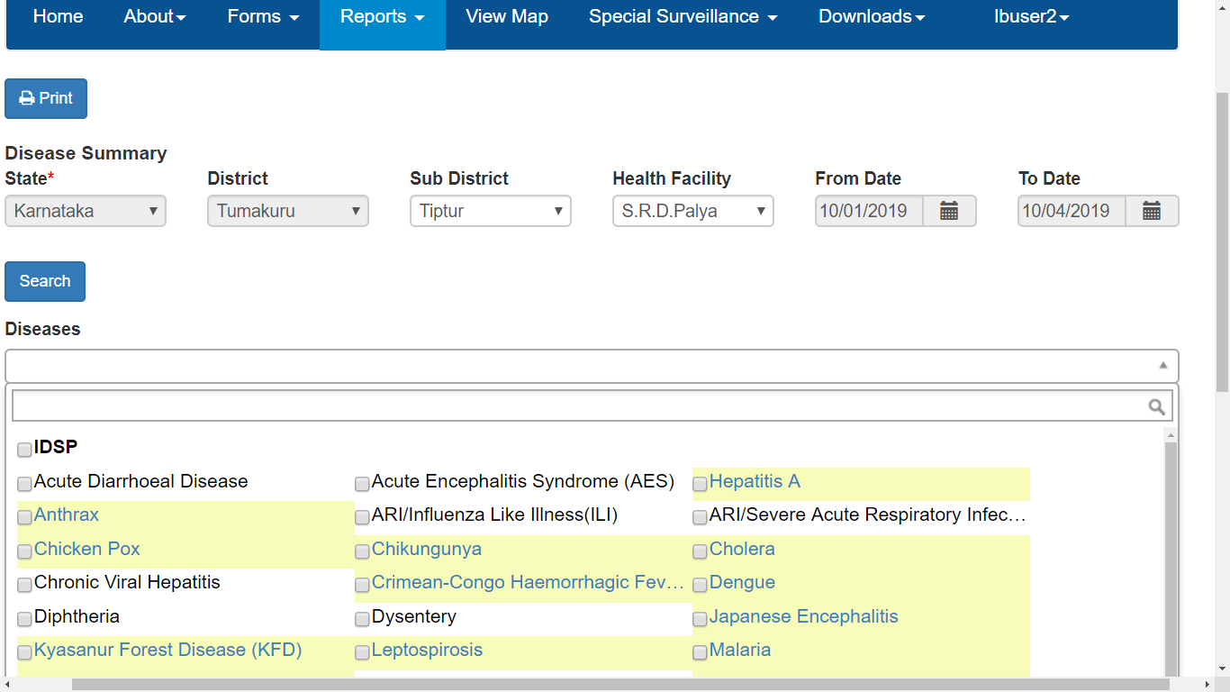
The diseases in the yellow indicates that the IHIP website has the data of these diseases

Slide 44
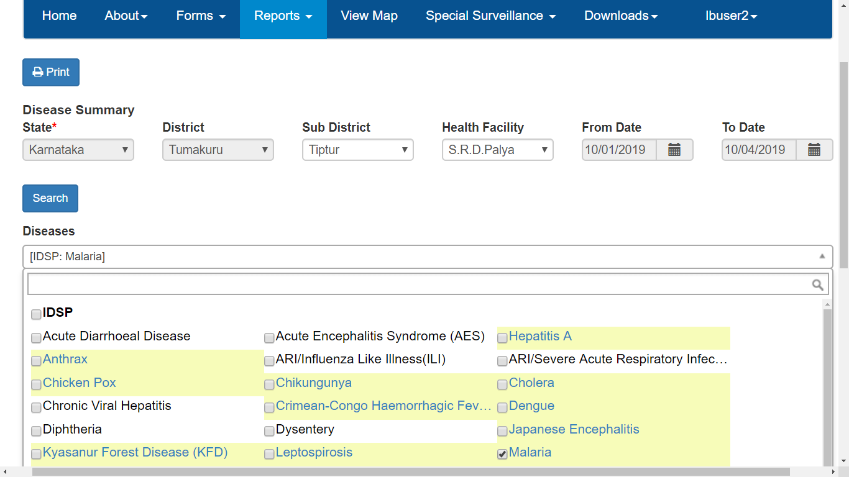
You may change the period as required
Select the diseases for which you want to see the summary; let’s select ‘Malaria’ for example and click “Search”

Slide 45
Number of cases
Pathogen distribution in Pie diagram
Line diagram of number of cases week wise (you may select week wise or month wise as per the requirement)

Slide 46
Click here to see the Cases on Map

Slide 47
To know the same, click on
‘-’ to zoom out
You will see the cases on map in a clustered manner

Slide 48
Click on any small cluster; here let’s take an example of cluster of 3 cases only
As you zoom in, the big clusters break in to smaller clusters

Slide 49
You will see the details of one case
To see all of the 3 cases in cluster, click on “View all 3 cases”

Slide 50
To see the Line List of the Cases

Slide 51
To download the Line List
Line List of the Cases

Slide 52
To see the week wise distribution of cases in Numbers only

Slide 53
To export the data
Week wise distribution of cases in Numbers with further distribution in
P cases and L cases

Slide 54
Reports → Reporting Status Summary

Slide 55
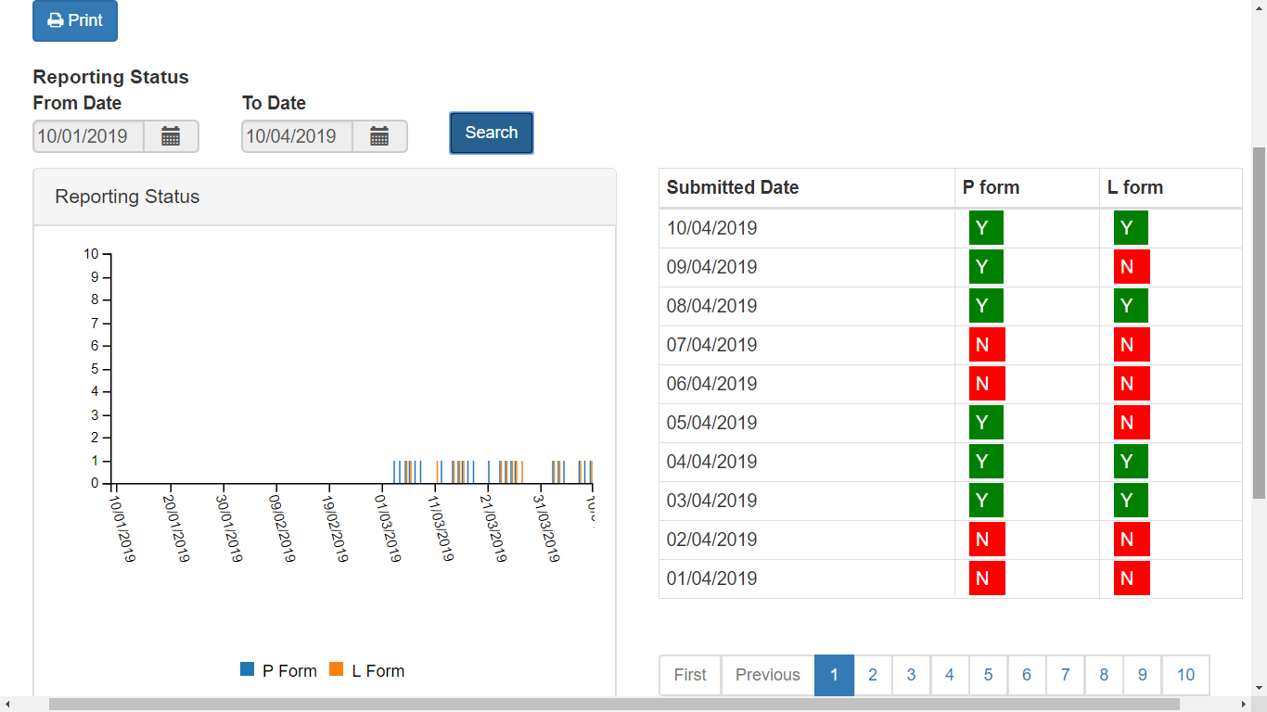
To Print the data in PDF
It will show the day wise reporting status of P and L forms submission for that facility

Slide 56
You may click on “Y” to get the pdf report of that particular day; it will show the summary of data with line listing

Slide 57
Reports → Laboratory Cases Form Summary

Slide 58
This report will show the data in aggregate i.e. number of cases entered through L form by you Health Facility; you can also change the “From Date” and “To Date”

Slide 59
By clicking on “Print” one can get the whole report in pdf which can be downloaded and printed
This report show the number of test/s performed for a particular disease (with the type/s of the test/s performed) along with number of positive samples (and distribution of the positive cases in Age and Gender)

Slide 60
Now, click on
“Patient History Report”

Slide 61
This report gives the list of the cases entered in the system (by P & L form users) for a particular health facility / a laboratory for the selected time line; you can change the From Date and To Date to change the time period for which the report is required
You can also get the details of the a particular patient or patients by using one or more of the identification filters like Mobile Number, First Name and ID type & number

Slide 62
A time period has been selected and then “Search” button has been clicked; and the following list is generated

Slide 63
By clicking on the patient name, you can get the “Patient Details Report” for that case in a pdf which can be printed and shared with the patient if required; it will also contain the result/s of the lab test/s of the case (if any)

Slide 64
One can click on “Export” to get the .csv file of the line list
One can click on these “Right Arrows” to expand the view of the line list with more columns

Slide 65
Now, click on
“Lab Performance Report”

Slide 66
This report gives disease wise frequency table having the cumulative number of the cases entered in the system by L form users of the health facility / a laboratory for the selected time line; you just need to select the From Date and To Date to and click on search to get the report for the selected time period; this report is particularly important for standalone labs like DPHLs, State Referral Labs, Privat labs etc

Slide 67
Here, a particular period has been selected and then “Search” button has been clicked; and the following frequency table is generated which is disease wise and contains the cumulative number of samples tested and cumulative number of positive cases for the selected time period
Let’s click on
Number ‘11’ here
You can click on this numbers to get the line list of those cases

Slide 68
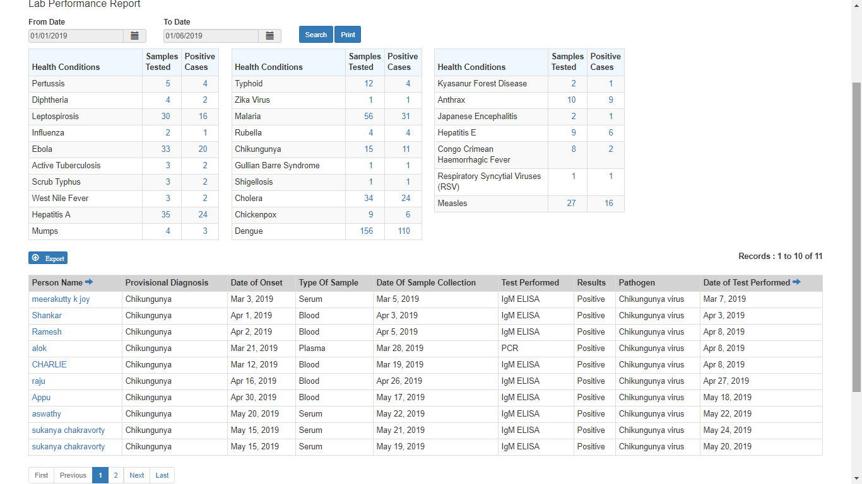
The report is showing the line list of all 11 positive cases of Chikungunya
By clicking on the patient name, you can get the “Patient Details report” for that case in a pdf which can be printed and shared with the patient if required; it will also contain the result/s of the lab test/s of the case

Slide 69
Click on
“View Map”

Slide 70
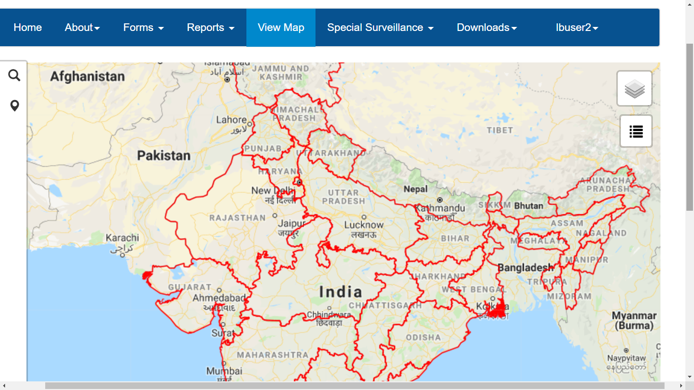
Click this Marker

Slide 71
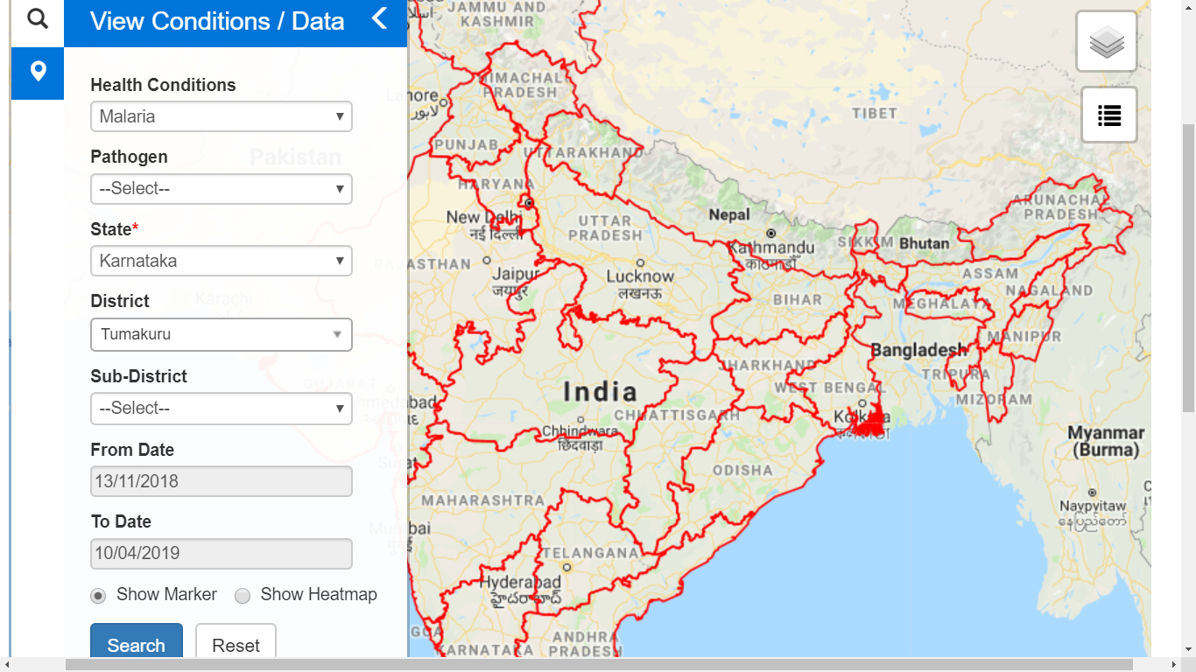
You can select “Health Condition”
and / or “Pathogen” for getting the location of the cases on Map
Then Click on “Search”

Slide 72
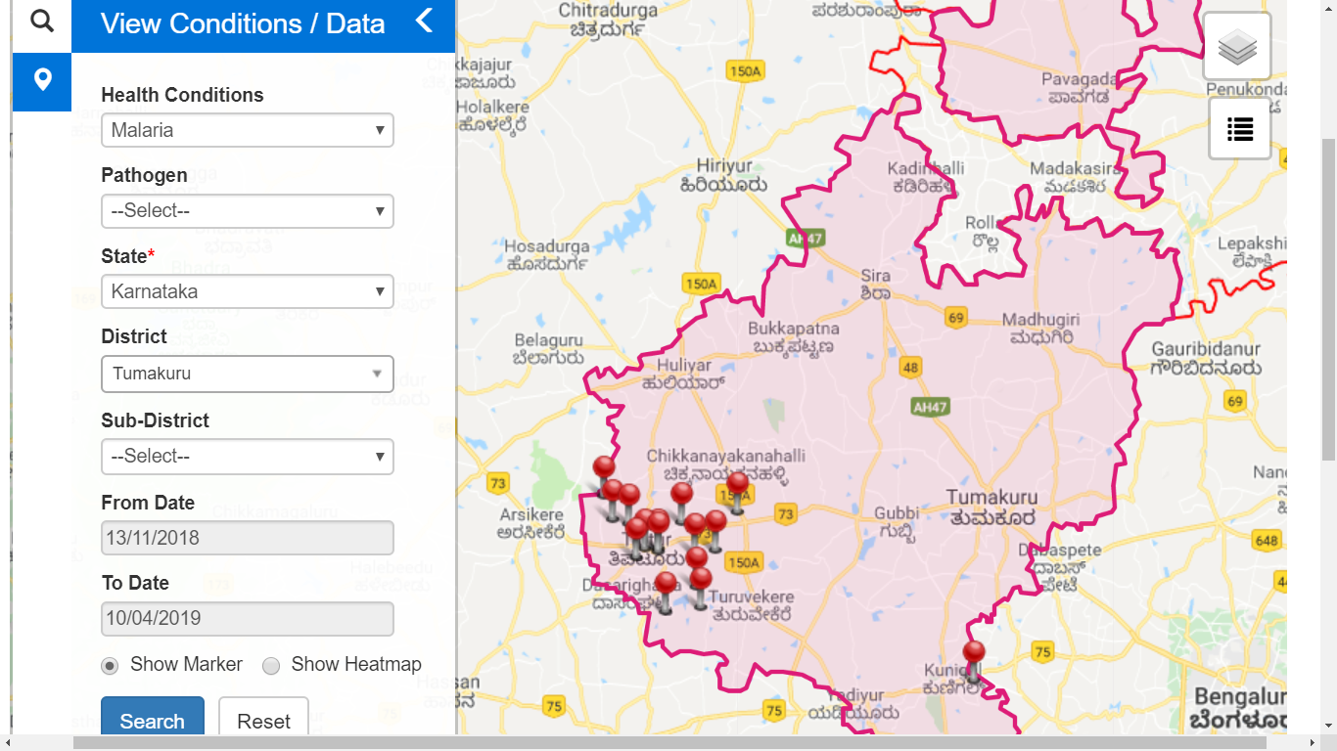
Click on this marker
Each marker indicate a case (or group of cases) for the selected Health Condition on map

Slide 73
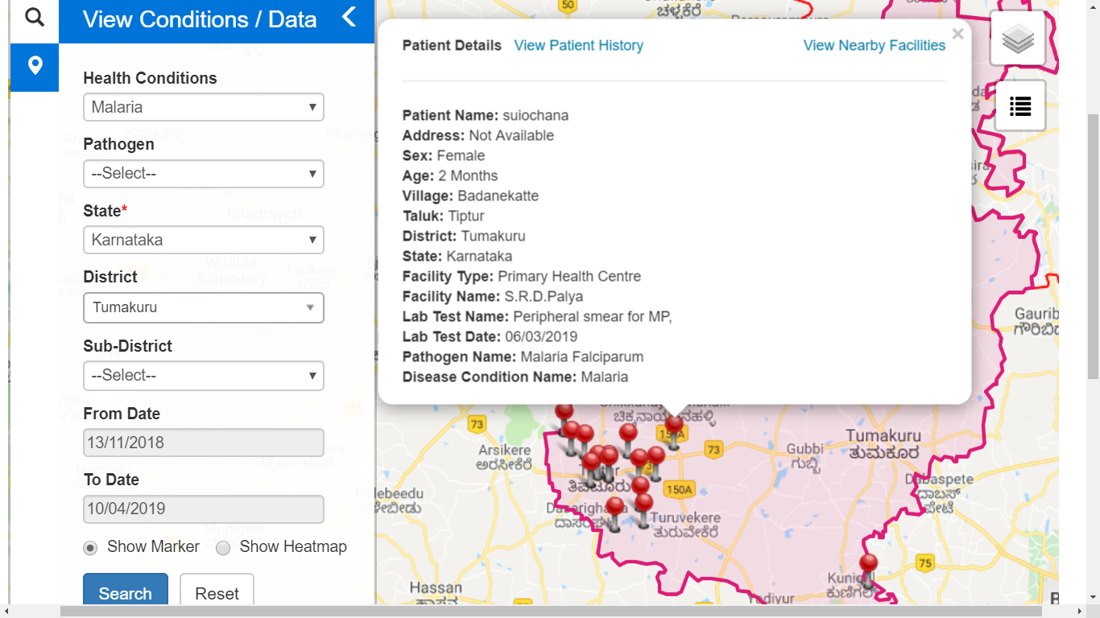
You will be able to see the details of the case; you may click on “View Patient History” (which will generate a pdf which can be downloaded/printed) and click on “View Nearby Facilities” to see the nearby health facilities on map
Select “Show Heatmap”
Then Click on “Search”

Slide 74
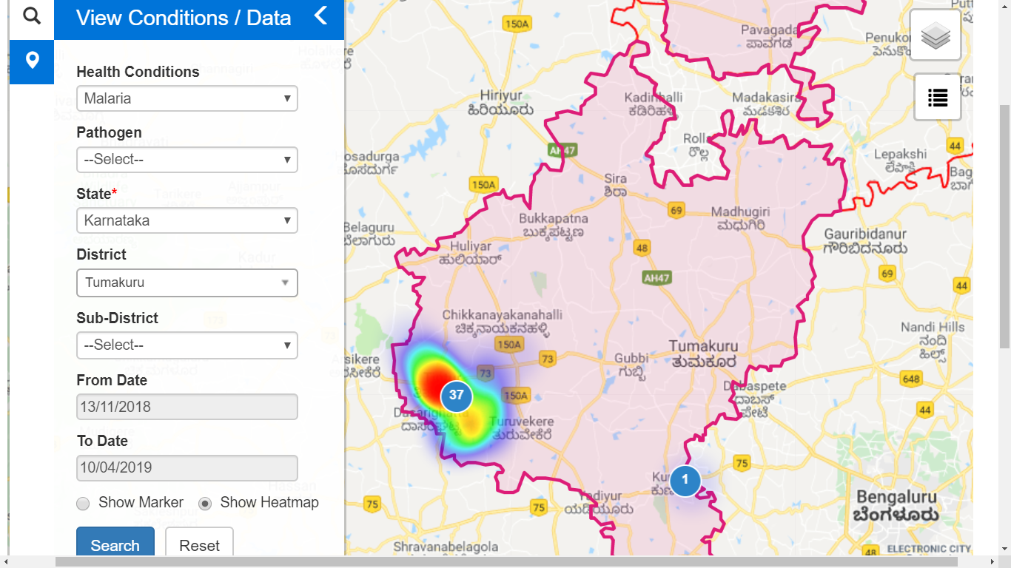
Heatmap will help us to locate the areas where the maximum number of cases are concentrated

Slide 75
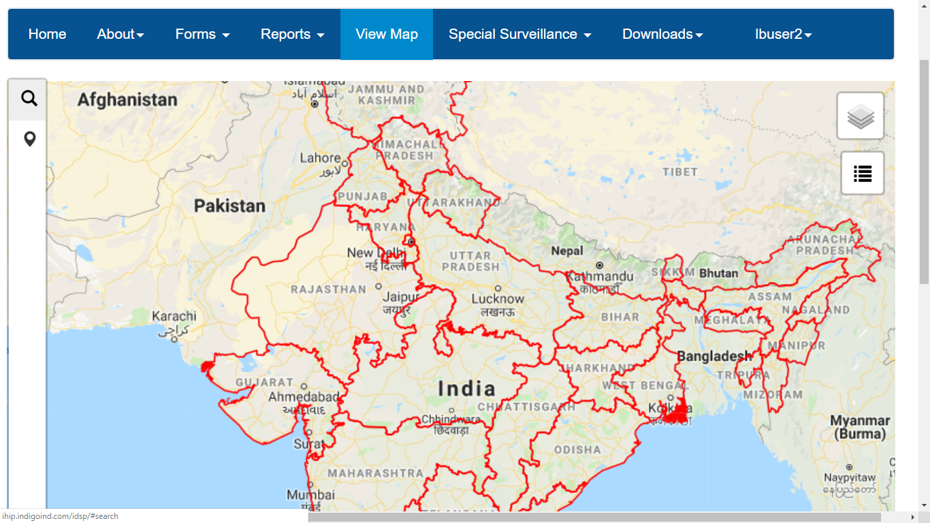
Click on this Search Tool

Slide 76
You can get the location of the health facilities on Map; you can select specific type of Health Facility
Then Click on “Search”

Slide 77
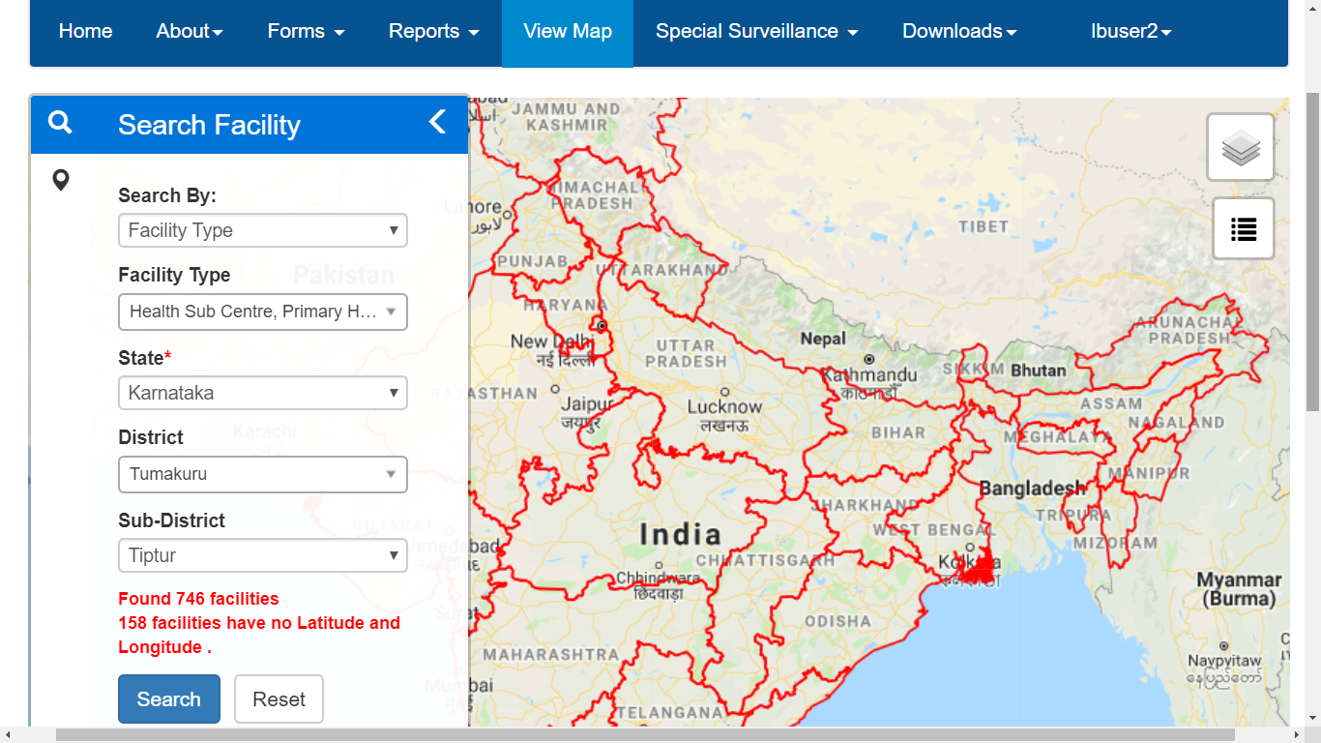
You can get the location of the health facilities on Map; you can select one or more Health Facility type/s
Then Click on “Search”

Slide 78
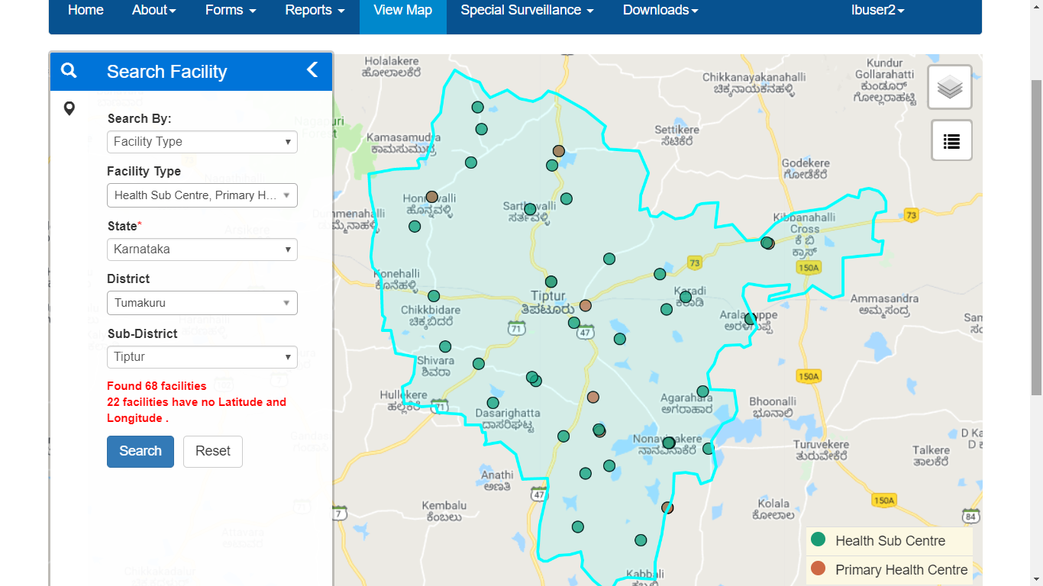
Click on this spot
Each spot indicates one Health Facility (here it’s a PHC)

Slide 79
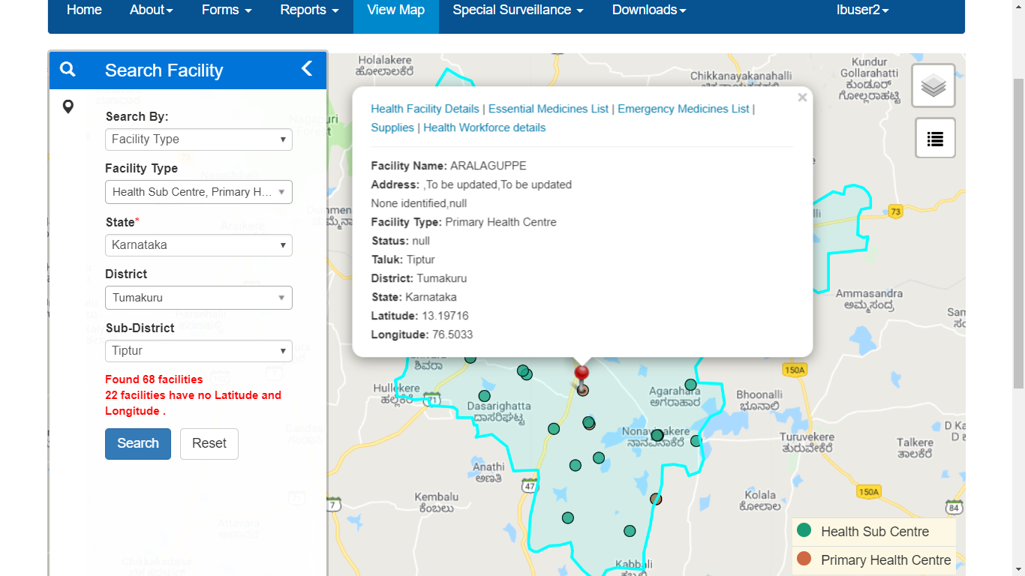
You will be able to see the details of the selected Health Facility; you may deep down in the health facility details by clicking on various hyperlinks like Essential Medicines List, Emergency Medicines List, Supplies, Health Workforce Details

Slide 80
Thank You

